Slide 1
Chapter 3 – last class:
Finding the empirical formula of a compound from % compositions
Start by assuming that you have 100.0g of the substance
Calculate the number of moles of each atom that is present in that sample. This provides the ratios of the atoms in the molecular formula.
Convert those numbers of moles into integer values.
Assigning Oxidation States to atoms in a compound
OS is the charge that an atom has, or would have, if it were to exchange electrons to form a bond with another.
    Apply a set of rules, in order, until you find the first one that applies to the compound that is being studied.
Determine the others by applying the rules about the total OS of a neutral compound or of an ion.

Slide 2
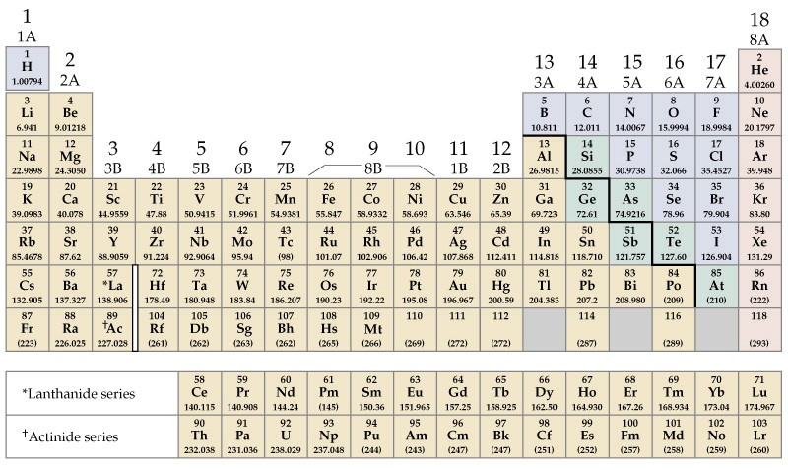
The Periodic table
Non Metals
Metals
Copyright © 2011 Pearson Canada Inc.
Notes:
Chemistry 140 Fall 2002

Slide 3
Naming Compounds
Inorganic Compounds
Binary compounds: (made up of only two types of atoms)
A metal and a nonmetal: Examples: NaCl, Hg₂Cl₂, CaF₂
Ionic
Write first the metal, then the nonmetal
Name of the metal followed by name of the non-metal with “ide” ending
NaCl Sodium chloride
Hg₂Cl₂ Mercury chloride
CaF₂ Calcium fluoride
(I)
If metal has more than one Oxidation State (OS)
put OS in parenthesis as roman numerals
BaS Fe₂Cl₃ AlH₃
Notes:
Chemistry 140 Fall 2002

Slide 4
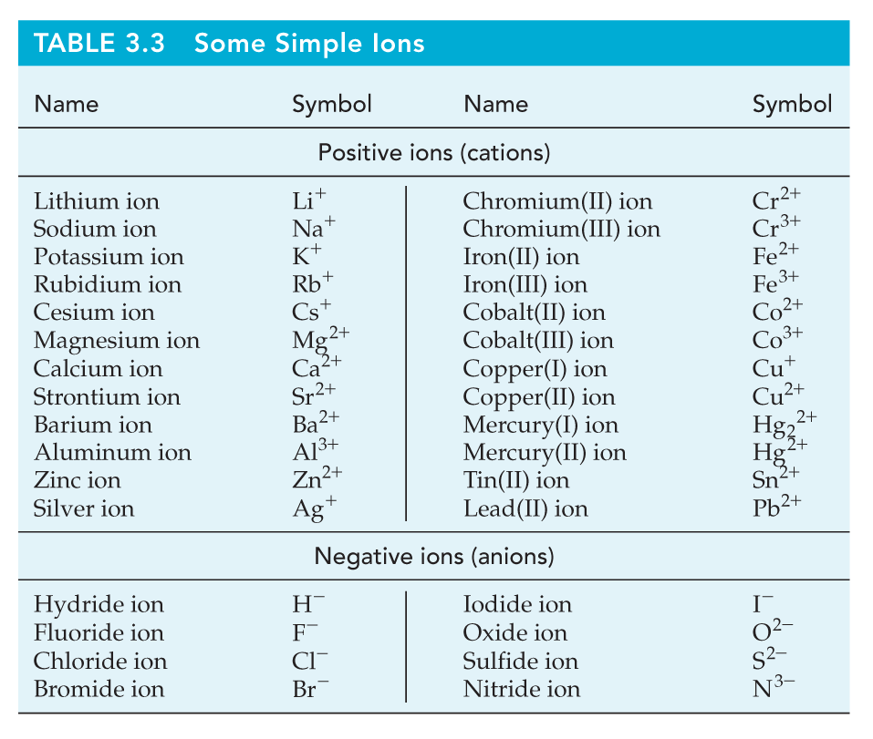
Metals
Non
Metals
General Chemistry: Chapter 3
Copyright © 2011 Pearson Canada Inc.
Notes:
Chemistry 140 Fall 2002

Slide 5
The Periodic table
Non Metals
Metals
Copyright © 2011 Pearson Canada Inc.
Notes:
Chemistry 140 Fall 2002

Slide 6
Naming Compounds
Inorganic Compounds
Two Nonmetals: Examples: HCl, N₂O₄, CO₂
Molecular or covalent (not ionic)
Write first the element with a positive OS
Name of the first atom followed by name of the non-metal with “ide” ending
HCl Hydrogen chloride (Hydrochloric acid)
If more than of the same atom, use latin prefixes (mono, di, tri, etc.)
N₂O₄ Dinitrogen pentoxide
CO₂ Carbon dioxide
phosphorus trichloride B₂Br₄
Some have “common names” H₂O NH₃
Notes:
Chemistry 140 Fall 2002

Slide 7
Examples
Write the formula for:
  Lithium oxide
  Phosphorus trichloride
  Tin(II) fluoride
Name the following compounds:
  CsI
  CaF₂
  N₂O
Notes:
Chemistry 140 Fall 2002

Slide 8
Binary Acids (general formula HX)
Acids produce H⁺ when dissolved in water.
They are compounds that ionize in water.
H₂S(aq) = hydrosulfuric acid
HI(aq) = hydroiodic acid
HCl(aq) = hydrochloric acid
HBr(aq) = hydrobromic acid
HF(aq) = hydrofluoric acid
The symbol (aq) signifies aqueous solution.
General Chemistry: Chapter 3
Copyright © 2011 Pearson Canada Inc.
Notes:
Chemistry 140 Fall 2002

Slide 9
Oxo Acids (general formula H_{z}XO_{y})
Also produce H⁺ when dissolved in water.
(XO_{y})^{z−} Polyatomic “oxo” ion
X is a nonmetal, can be C, Cl, S, N, etc.
X may have more than one oxidation state (OS)
Examples:
OS of Cl
ClOˉ
ClO₂ ˉ
ClO₃ ˉ
ClO₄ ˉ
Notes:
Chemistry 140 Fall 2002

Slide 10
Polyatomic Ions : “Oxo-anions”
Increasing oxidation state of nonmetal
hypo___ite ___ite ___ate per___ate
Increasing number of oxygen atoms :
ClOˉ ClO₂ ˉ ClO₃ ˉ ClO₄ ˉ
hypochlorite chlorite chlorate perchlorate
HClO HClO₂ HClO₃ HClO₄
Hypochlorous acid chlorous acid chloric acid perchloric acid
OS: +1 +3 +5 +7
Notes:
3. An element common to many polyatomic anions is oxygen, usually in
combination with another nonmetal. Such anions are called oxoanions.
4. Certain nonmetals (such as Cl, N, P, and S) form a series of oxoanions containing
different numbers of oxygen atoms. Their names are related to the
oxidation state of the nonmetal atom to which the O atoms are bonded,
ranging from hypo- (lowest) to per- (highest) according to the following
scheme.
Chemistry 140 Fall 2002

Slide 11
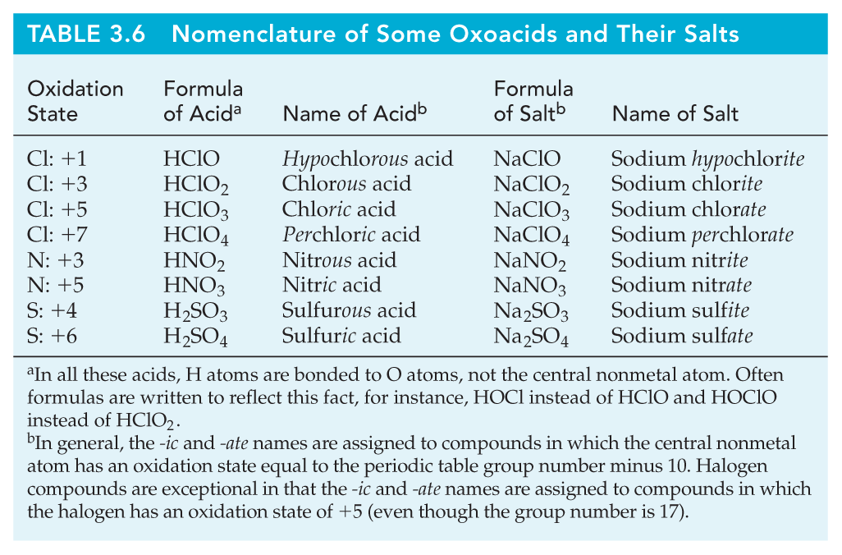
If we substitute the H⁺ by a metal ion we form a “salt”
SO₃⁻² SO₄⁻²
OS(S) +4 +6
Sulfurous Sulfuric
sulfite sulfate
Notes:
Chemistry 140 Fall 2002

Slide 12
Organic Compounds
Compounds of C, H and sometimes O, N, S, etc.
Carbon atoms form chains and rings and act as the framework of molecules.
General Chemistry: Chapter 3
Copyright © 2011 Pearson Canada Inc.
Notes:
Chemistry 140 Fall 2002

Slide 13
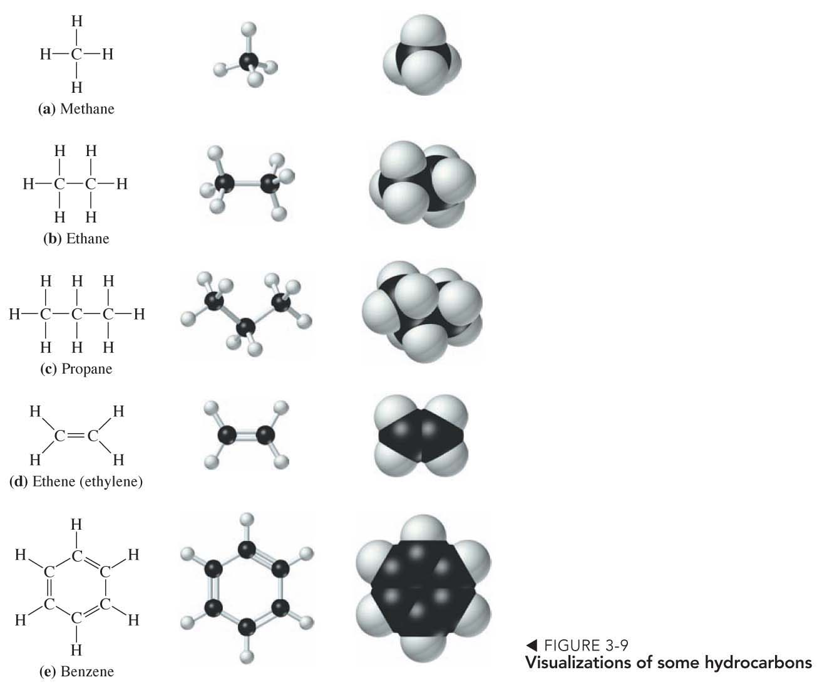
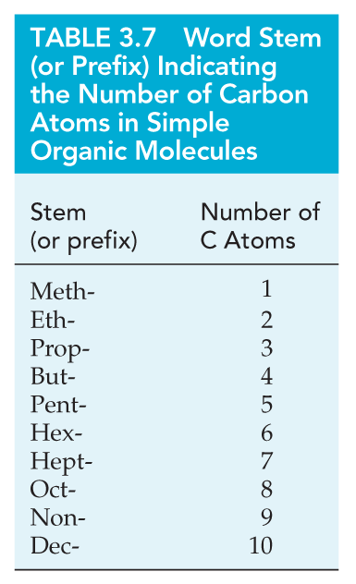
Hydrocarbons
alkanes
alkenes
cyclic
Notes:
Chemistry 140 Fall 2002

Slide 14
Isomers
Isomers have the same molecular formula but have different arrangements of atoms in space.
C₄H₁₀
butane
CH₃―CH₂―CH₂―CH₃
CH₃
|
CH₃―CH―CH₃
methyl propane
Notes:
Chemistry 140 Fall 2002

Slide 15
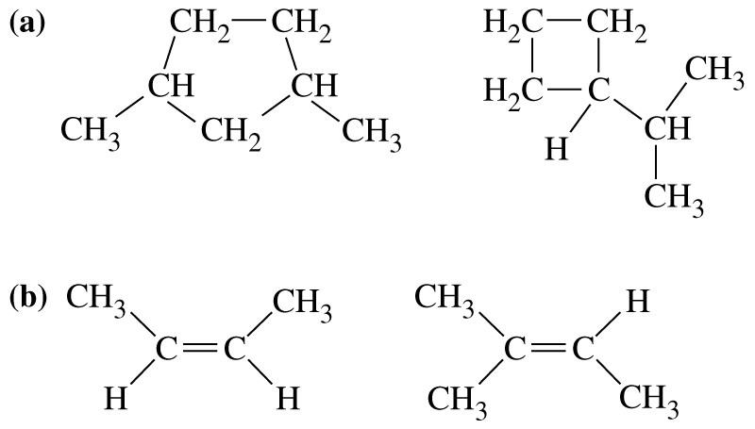
Isomers
Isomers have the same molecular formula but have different arrangements of atoms in space. Are the following pairs isomers?
(c)
H
Slide <number> of 32
General Chemistry: Chapter 3
Copyright © 2011 Pearson Canada Inc.
Notes:
Chemistry 140 Fall 2002

Slide 16
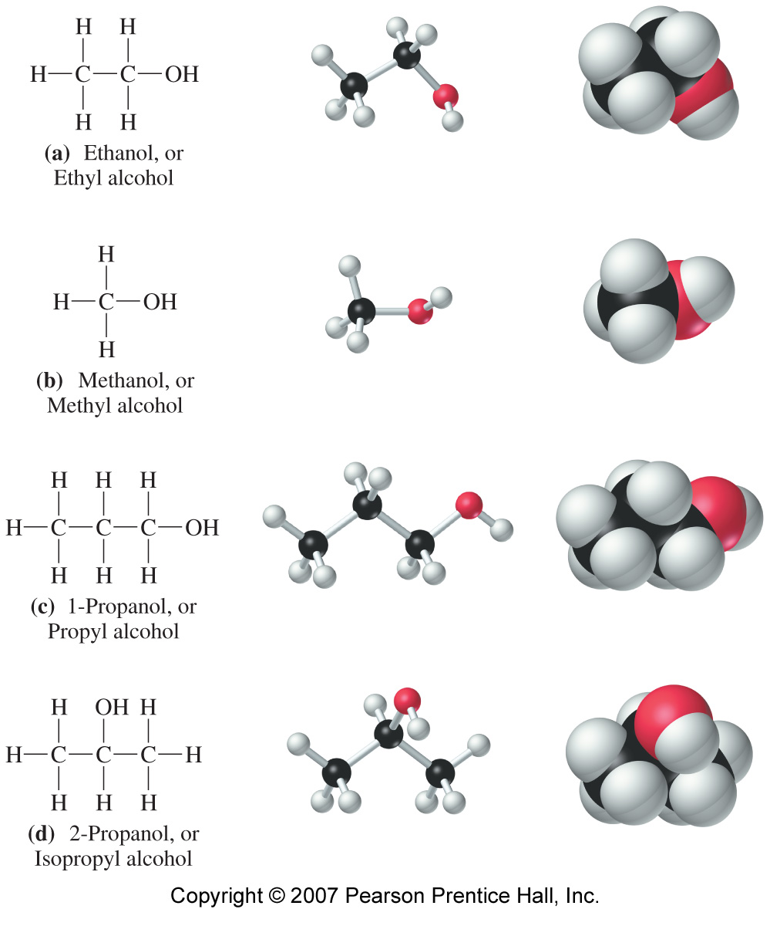
Functional Groups
“Hydroxyl group”
-OH
Alcohols
Notes:
Chemistry 140 Fall 2002

Slide 17
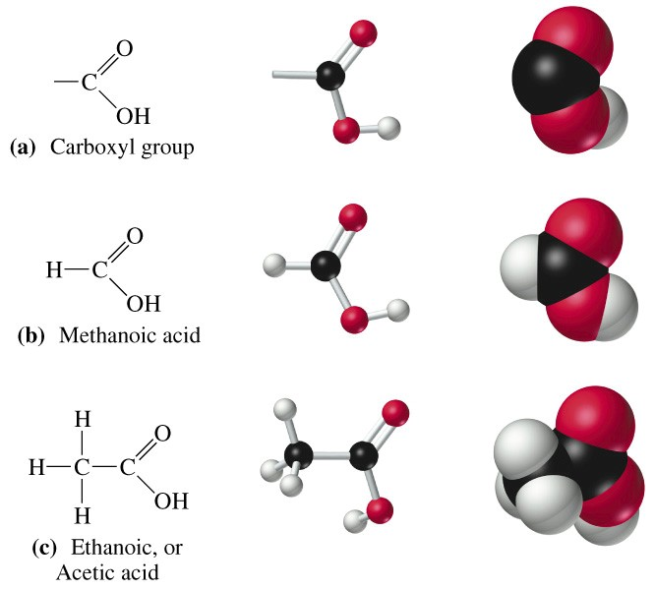
The carboxyl group and visualizations of two carboxylic acids
“Carboxyl group”
-COOH
Acids
Notes:
Chemistry 140 Fall 2002

Slide 18
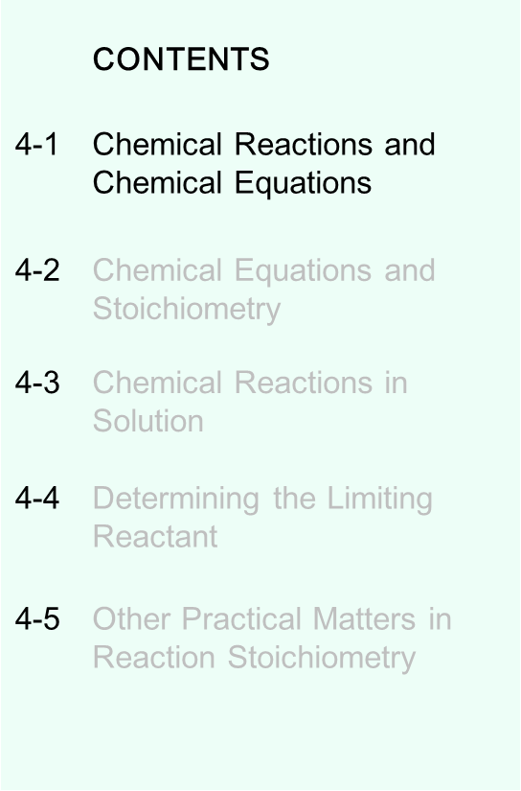
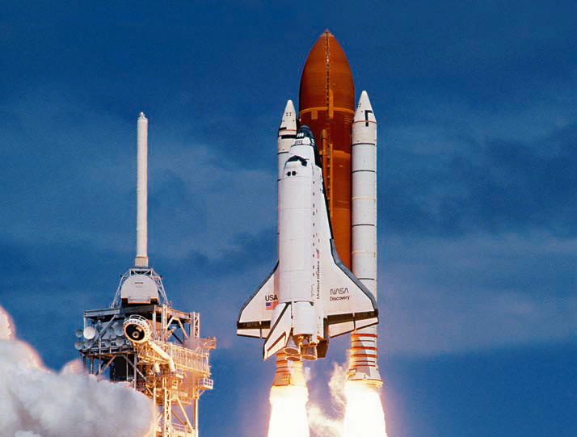
Chapter 4: Chemical Reactions
Copyright © 2011 Pearson Canada Inc.
Notes:
Chemistry 140 Fall 2002

Slide 19
Chemical Reactions
A set of substances are mixed and converted into a new set of substances
A + B + C + … → X + Y + Z + …
Reactants Products
As reactants are converted to products (sometimes) we observe:
  Color change
  Precipitate formation
  Gas evolution
  Heat absorption or evolution
General Chemistry: Chapter 4
Copyright © 2011 Pearson Canada Inc.
Notes:
Chemistry 140 Fall 2002

Slide 20
Chemical Reactions
A set of substances are mixed and converted into a new set of substances
Chemical Equation
A + B + C + … → X + Y + Z + …
Reactants Products
Example: Methane plus oxygen produce carbon dioxide and water
CH₄ + O₂ → CO₂ + H₂O
Conservation of mass: atoms are not created or destroyed in a chemical reaction.
Must “balance” the equation.
Copyright © 2011 Pearson Canada Inc.
Notes:
Chemistry 140 Fall 2002

Slide 21
Balancing Equations
An equation can be balanced only by adjusting the coefficients of formulas.
NO + O₂ → NO₂
Never introduce extraneous atoms to balance.
NO + O₂ → NO₂ + O
===
Never change a formula for the purpose of balancing an equation.
NO + O₂ → NO₃
= ₂
Balancing Equation Strategy: Trial and error
Tips:
Balance elements that occur in only one compound on each side first.
Balance free elements last.
Fractional coefficients are OK.
Notes:
Chemistry 140 Fall 2002

Slide 22
Chemical Reactions
Nitrogen monoxide + oxygen → nitrogen dioxide
Step 1: Write the reaction using chemical symbols.
Step 2: Balance the chemical equation.
½
NO + O₂ → NO₂
Slide <number> of 24
General Chemistry: Chapter 4
Copyright © 2011 Pearson Canada Inc.
Notes:
Chemistry 140 Fall 2002

Slide 23
Chemical Reactions
Nitrogen monoxide + oxygen → nitrogen dioxide
Step 1: Write the reaction using chemical symbols.
Step 2: Balance the chemical equation.
2
1
2
NO + O₂ → NO₂
Slide <number> of 24
General Chemistry: Chapter 4
Copyright © 2011 Pearson Canada Inc.
Notes:
Chemistry 140 Fall 2002

Slide 24
Example – Balancing equations
H₃PO₄ + CaO → Ca₃(PO₄)₂ + H₂O
2
3
3
H 3 2
Ca 1 3
PO₄ 1 2
O 1 1
X 2 =6
X 3 =6
X 3 =3
X 2 = 2
X 3 =3
X 3 =3
Tip #4. When a group of atoms (polyatomic ions) remains unchanged before and after the reaction, treat it as an “atom”
NH₃ + O₂ → NO₂ + H₂O
2NH₃ + 7/2 O₂ → 2NO₂ + 3H₂O
4NH₃ + 7O₂ → 4NO₂ + 6H₂O
Notes:
Chemistry 140 Fall 2002

Slide 25
Example
Write and balance the equation for the following reaction:
Mercury(II)sulfide and calcium oxide produce calcium sulfide, calcium sulfate and mercury
HgS + CaO → CaS + CaSO₄ + Hg
Notes:
Chemistry 140 Fall 2002

Slide 26
Example
Write and balance the equation for the following reaction:
Mercury(II)sulfide and calcium oxide produce calcium sulfide, calcium sulfate and mercury
HgS + CaO → CaS + CaSO₄ + Hg
4
4
3
4
Hg 1 1
Ca 1 1 + 1
S 1 1 + 1
O 1 4
X 4 = 4
X 4
X 4 = 4
X 3 = 3
X 4 = 4
X 3 = 3
X 4 = 4
Do O first (appears only once in each side)
O changes Ca, so do Ca next. (Two possible ways, trial and error)
Ca changes S, so do S next.
S changes Hg, so do Hg.
Check to see if it is balanced.
Notes:
Chemistry 140 Fall 2002

Slide 27
Other information
States of matter
(g) gas (l) liquid (s) solid
2 C₆H₁₄O₄(l) + 15 O₂(g) 12 CO₂(g) + 14 H₂O(l)
For reactants or products dissolved in water: (aq) aqueous solution
Reaction conditions
Temperature, pressure, catalysts, …
350 ºC
CO₂(g) + 2H₂(g) CH₃OH(g)
340 atm
ZnO, Cr₂O₃
Notes:
Chemistry 140 Fall 2002

